Slide 1
დისკრეტული მათემატიკა
პრაქტიკული 1

Slide 2

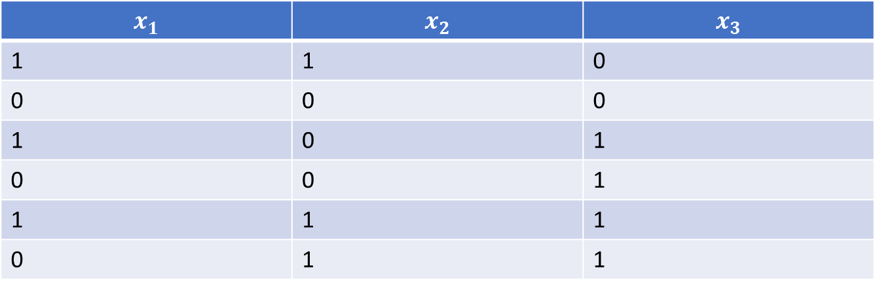



$$x_{1}$$ | $$x_{2}$$ | $$x_{3}$$
1 | 1 | 0
0 | 0 | 0
1 | 0 | 1
0 | 0 | 1
1 | 1 | 1
0 | 1 | 1
$\overline{x_{1}}$⋀${(x}_{3}$⋁$\overline{\overline{x_{3}}\text{⋀}{(x}_{3}\text{⋁}\overline{x_{2}))}}$
$\overline{x_{2}}$ ⋁ ${(x}_{1}$⋁$\overline{\overline{x_{3}}\text{⋀}{(x}_{1}\text{⋁}\overline{x_{2}))}}$
$\overline{(x_{2}}$⋁$\overline{x_{1}}$)⋀$x_{3}\text{⋁}\overline{{(x}_{1}}$⋀$x_{3})$⋀$x_{2}$
$\overline{(x_{1}}$⋁$\overline{x_{3}}$)⋀$x_{2}\text{⋁}\overline{{(x}_{2}}$⋀$x_{3})$⋀$x_{1}$

Slide 3

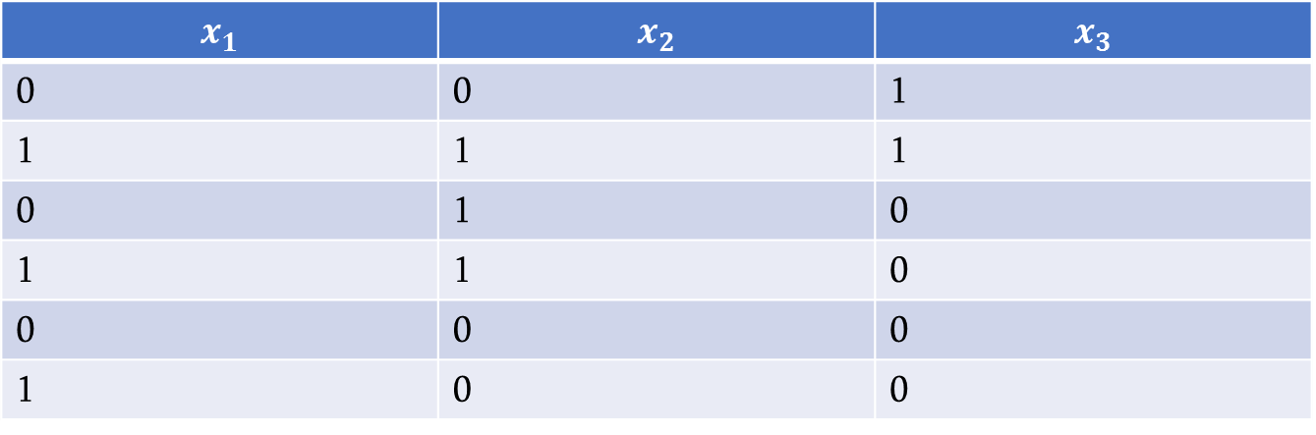


$$x_{1}$$ | $$x_{2}$$ | $$x_{3}$$
0 | 0 | 1
1 | 1 | 1
0 | 1 | 0
1 | 1 | 0
0 | 0 | 0
1 | 0 | 0
$\overline{x_{1}}$⋀${(x}_{2}$⋁$\overline{\overline{x_{3}}\text{⋀}{(x}_{1}\text{⋁}\overline{x_{2}))}}$
$\overline{x_{1}}$ ⋁ ${(x}_{1}$⋁$\overline{\overline{x_{3}}\text{⋀}{(x}_{3}\text{⋁}\overline{x_{2}))}}$
$\overline{(x_{2}}$⋁$\overline{x_{3}}$)⋀$x_{2}\text{⋁}\overline{{(x}_{3}}$⋀$x_{1})$⋀$x_{2}$
$\overline{(x_{1}}$⋁$\overline{x_{3}}$)⋀$x_{2}\text{⋁}\overline{{(x}_{2}}$⋀$x_{3})$⋀$x_{1}$

Slide 4

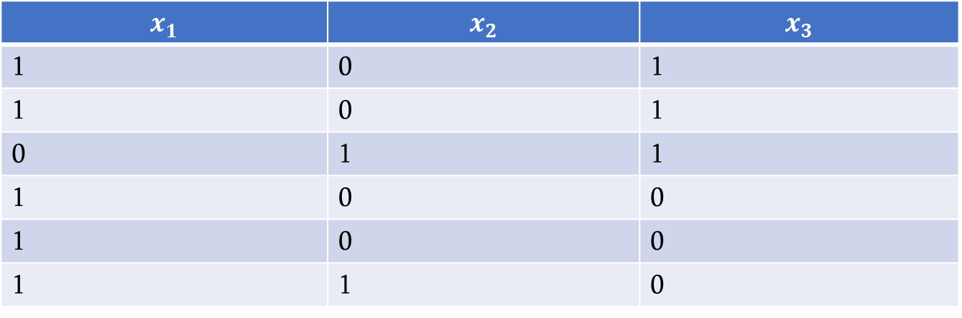



$$x_{1}$$ | $$x_{2}$$ | $$x_{3}$$
1 | 0 | 1
1 | 0 | 1
0 | 1 | 1
1 | 0 | 0
1 | 0 | 0
1 | 1 | 0
$\overline{x_{3}}$⋀$x_{2}$⋁$\overline{\overline{x_{3}}\text{⋀}{(x}_{3}\text{⋁}\overline{x_{2})}}$
$\overline{x_{1}}$ ⋁ $x_{2}$⋁$\overline{\overline{x_{3}}\text{⋀}{(x}_{1}\text{⋁}\overline{x_{2})}}$
$\overline{(x_{2}}$⋁$\overline{x_{3}}$)⋀$x_{2}\text{⋁}\overline{{(x}_{3}}$⋀$x_{2})$⋀$x_{3}$
$\overline{(x_{1}}$⋁$\overline{x_{2}}$)⋀$x_{2}\text{⋁}\overline{{(x}_{2}}$⋀$x_{1})$⋀$x_{1}$

Slide 5

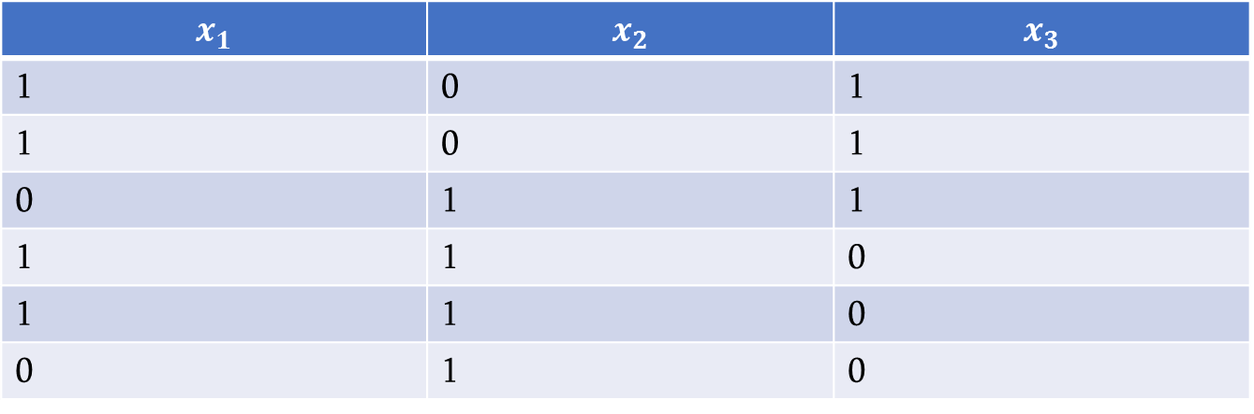


$$x_{1}$$ | $$x_{2}$$ | $$x_{3}$$
1 | 0 | 1
1 | 0 | 1
0 | 1 | 1
1 | 1 | 0
1 | 1 | 0
0 | 1 | 0
$\overline{x_{1}}$⋀$x_{3}$⋁$\overline{\overline{x_{2}}\text{⋀}{(x}_{3}\text{⋁}\overline{x_{2})}}$
$\overline{x_{1}}$ ⋁ $x_{3}$⋁$\overline{\overline{x_{3}}\text{⋀}{(x}_{3}\text{⋁}\overline{x_{2})}}$
$\overline{(x_{2}}$⋁$\overline{x_{3}}$)⋀$x_{2}\text{⋁}\overline{{(x}_{3}}$⋀$x_{1})$⋀$x_{2}$
$\overline{(x_{1}}$⋁$\overline{x_{2}}$)⋀$x_{3}\text{⋁}\overline{{(x}_{2}}$⋀$x_{1})$⋀$x_{3}$

Slide 6

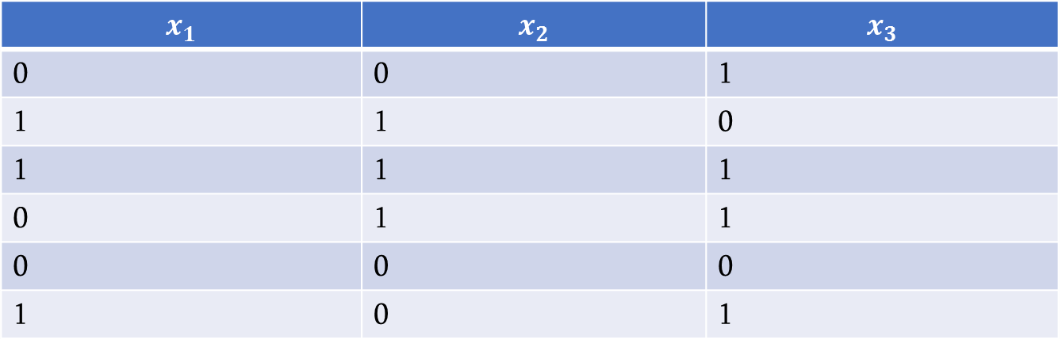

$$x_{1}$$ | $$x_{2}$$ | $$x_{3}$$
0 | 0 | 1
1 | 1 | 0
1 | 1 | 1
0 | 1 | 1
0 | 0 | 0
1 | 0 | 1
$\overline{x_{1}}$⋀$x_{2}$⋁$\overline{\overline{x_{3}}\text{⋀}{(x}_{1}\text{⋁}\overline{x_{2})}}$
$\overline{x_{1}}$ ⋁ $x_{2}$⋁$\overline{\overline{x_{1}}\text{⋀}{(x}_{3}\text{⋁}\overline{x_{2})}}$
$\overline{(x_{2}}$⋁$\overline{x_{3}}$)⋀$x_{2}\text{⋁}\overline{{(x}_{3}}$⋀$x_{1})$⋀$x_{2}$
$\overline{(x_{1}}$⋁$\overline{x_{2}}$)⋀$x_{3}\text{⋁}\overline{{(x}_{2}}$⋀$x_{1})$⋀$x_{3}$

Slide 7


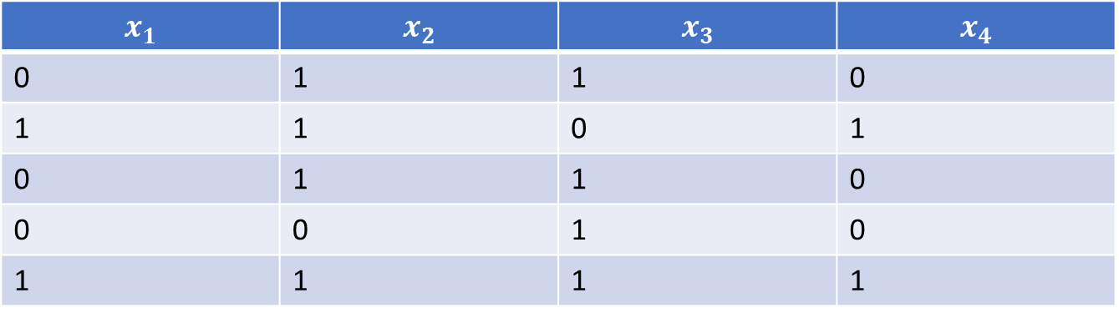


$$x_{1}$$ | $$x_{2}$$ | $$x_{3}$$ | $$x_{4}$$
0 | 1 | 1 | 0
1 | 1 | 0 | 1
0 | 1 | 1 | 0
0 | 0 | 1 | 0
1 | 1 | 1 | 1
$\overline{x_{1}}$⋀$x_{2}$⋁$\overline{\overline{x_{3}}\text{⋀}{(x}_{4}\text{⋁}\overline{x_{2})}}$
$\overline{x_{1}}$ ⋁ $x_{4}$⋁$\overline{\overline{x_{1}}\text{⋀}{(x}_{3}\text{⋁}\overline{x_{2})}}$
$\overline{(x_{2}}$⋁$\overline{x_{3}}$)⋀$x_{2}\text{⋁}\overline{{(x}_{3}}$⋀$x_{1})$⋀$x_{4}$
$\overline{(x_{1}}$⋁$\overline{x_{4}}$)⋀$x_{3}\text{⋁}\overline{{(x}_{2}}$⋀$x_{1})$⋀$x_{3}$

Slide 8

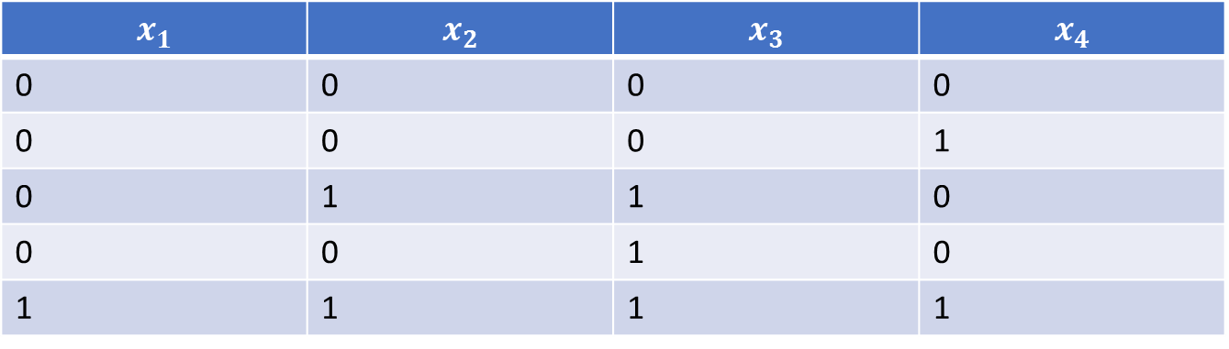
$$x_{1}$$ | $$x_{2}$$ | $$x_{3}$$ | $$x_{4}$$
0 | 0 | 0 | 0
0 | 0 | 0 | 1
0 | 1 | 1 | 0
0 | 0 | 1 | 0
1 | 1 | 1 | 1
$\overline{x_{1}}$⋀$x_{3}$⋁$\overline{\overline{x_{2}}\text{⋀}{(x}_{1}\text{⋁}\overline{x_{4})}}$
$\overline{x_{1}}$ ⋁ $x_{4}$⋁$\overline{\overline{x_{1}}\text{⋀}{(x}_{3}\text{⋁}\overline{x_{2})}}$
$\overline{(x_{2}}$⋁$\overline{x_{3}}$)⋀$x_{2}\text{⋁}\overline{{(x}_{3}}$⋀$x_{1})$⋀$x_{4}$
$\overline{(x_{1}}$⋁$\overline{x_{4}}$)⋀$x_{3}\text{⋁}\overline{{(x}_{2}}$⋀$x_{1})$⋀$x_{3}$

Slide 9


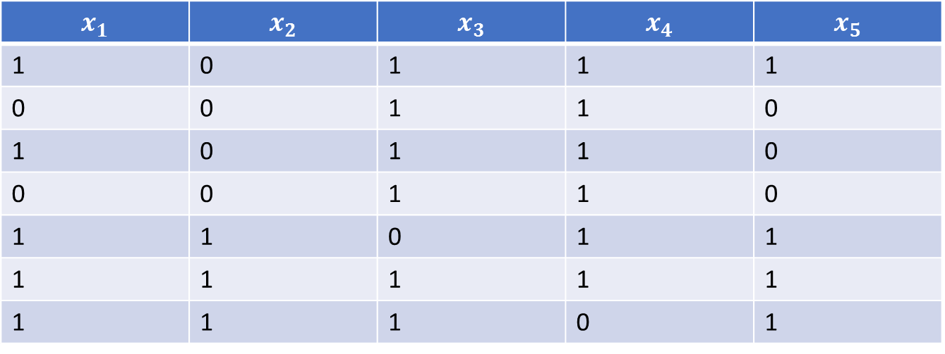


$$x_{1}$$ | $$x_{2}$$ | $$x_{3}$$ | $$x_{4}$$ | $$x_{5}$$
1 | 0 | 1 | 1 | 1
0 | 0 | 1 | 1 | 0
1 | 0 | 1 | 1 | 0
0 | 0 | 1 | 1 | 0
1 | 1 | 0 | 1 | 1
1 | 1 | 1 | 1 | 1
1 | 1 | 1 | 0 | 1
$\overline{x_{1}}$⋀$x_{3}$⋁$\overline{\overline{x_{5}}\text{⋀}{(x}_{2}\text{⋁}\overline{x_{4})}}$
$\overline{x_{1}}$ ⋁ $x_{4}$⋁$\overline{\overline{x_{1}}\text{⋀}{(x}_{3}\text{⋁}\overline{x_{2}) }}\overline{{\text{⋁}(x}_{1}}\text{ ⋁ }x_{5})$
$\overline{(x_{2}}$⋁$\overline{x_{3}}$)⋀$x_{2}\text{⋁}\overline{{(x}_{5}}$⋀$x_{1})$⋀$x_{4}$
$\overline{(x_{1}}$⋁$\overline{x_{4}}$)⋀$x_{3}\text{⋁}\overline{{(x}_{2}}$⋀$x_{1})$⋀$x_{3}\text{⋁}(\overline{x_{1}}$ ⋁ $x_{5}$)

Slide 10

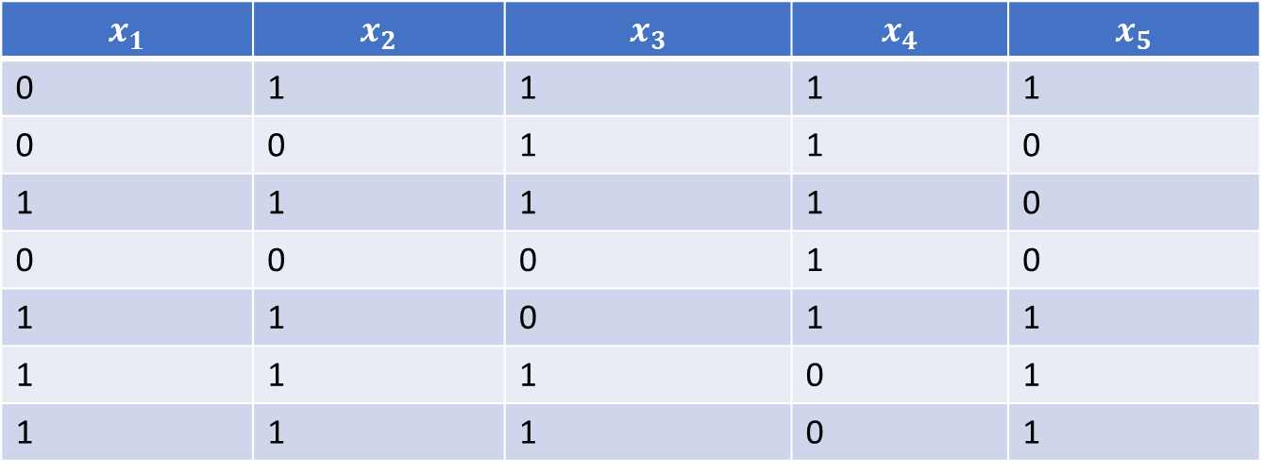
$$x_{1}$$ | $$x_{2}$$ | $$x_{3}$$ | $$x_{4}$$ | $$x_{5}$$
0 | 1 | 1 | 1 | 1
0 | 0 | 1 | 1 | 0
1 | 1 | 1 | 1 | 0
0 | 0 | 0 | 1 | 0
1 | 1 | 0 | 1 | 1
1 | 1 | 1 | 0 | 1
1 | 1 | 1 | 0 | 1
$\overline{x_{1}}$⋀$x_{5}$⋁$\overline{\overline{x_{3}}\text{⋀}{(x}_{2}\text{⋁}\overline{x_{4})}}$
$\overline{x_{1}}$ ⋁ $x_{4}$⋁$\overline{\overline{x_{1}}\text{⋀}{(x}_{3}\text{⋁}\overline{x_{2}) }}\overline{{\text{⋁}(x}_{1}}\text{ ⋁ }x_{5})$
$\overline{(x_{2}}$⋁$\overline{x_{3}}$)⋀$x_{2}\text{⋁}\overline{{(x}_{5}}$⋀$x_{1})$⋀$x_{4}$
$\overline{(x_{1}}$⋁$\overline{x_{4}}$)⋀$x_{3}\text{⋁}\overline{{(x}_{2}}$⋀$x_{1})$⋀$x_{3}\text{⋁}(\overline{x_{1}}$ ⋁ $x_{5}$)

Slide 11
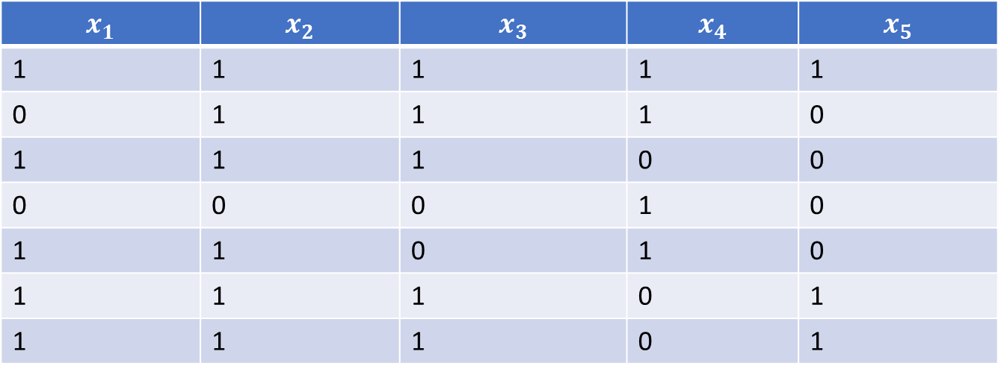


$$x_{1}$$ | $$x_{2}$$ | $$x_{3}$$ | $$x_{4}$$ | $$x_{5}$$
1 | 1 | 1 | 1 | 1
0 | 1 | 1 | 1 | 0
1 | 1 | 1 | 0 | 0
0 | 0 | 0 | 1 | 0
1 | 1 | 0 | 1 | 0
1 | 1 | 1 | 0 | 1
1 | 1 | 1 | 0 | 1
$\overline{x_{1}}$⋀$x_{5}$⋁$\overline{\overline{x_{3}}\text{⋀}{(x}_{2}\text{⋁}\overline{x_{4})}}$
$\overline{x_{1}}$ ⋁ $x_{4}$⋁$\overline{\overline{x_{1}}\text{⋀}{(x}_{3}\text{⋁}\overline{x_{2}) }}\overline{{\text{⋁}(x}_{1}}\text{ ⋁ }x_{5})$
$\overline{(x_{2}}$⋁$\overline{x_{5}}$)⋀$x_{2}\text{⋁}\overline{{(x}_{5}}$⋀$x_{1})$⋀$x_{4}$
$\overline{(x_{1}}$⋁$\overline{x_{5}}$)⋀$x_{3}\text{⋁}\overline{{(x}_{2}}$⋀$x_{5})$⋀$x_{3}\text{⋁}(\overline{x_{1}}$ ⋁ $x_{5}$)

Slide 12


$$x_{1}$$ | $$x_{2}$$ | $$x_{3}$$ | $$x_{4}$$ | $$x_{5}$$
1 | 1 | 1 | 1 | 1
0 | 1 | 1 | 1 | 0
1 | 1 | 1 | 0 | 0
0 | 0 | 0 | 1 | 0
1 | 1 | 0 | 1 | 0
1 | 1 | 1 | 0 | 1
1 | 1 | 1 | 0 | 1
$\overline{x_{1}}$⋀$x_{5}$⋁$\overline{\overline{x_{3}}\text{⋀}{(x}_{2}\text{⋁}\overline{x_{4})}}$
$\overline{x_{1}}$ ⋁ $x_{4}$⋁$\overline{\overline{x_{1}}\text{⋀}{(x}_{3}\text{⋁}\overline{x_{2}) }}\overline{{\text{⋁}(x}_{1}}\text{ ⋁ }x_{5})$
$\overline{(x_{2}}$⋁$\overline{x_{5}}$)⋀$x_{2}\text{⋁}\overline{{(x}_{5}}$⋀$x_{1})$⋀$x_{1}$
$\overline{(x_{1}}$⋁$\overline{x_{2}}$)⋀$x_{3}\text{⋁}\overline{{(x}_{2}}$⋀$x_{5})$⋀$x_{3}\text{⋁}(\overline{x_{1}}$ ⋁ $x_{5}$)

Slide 13
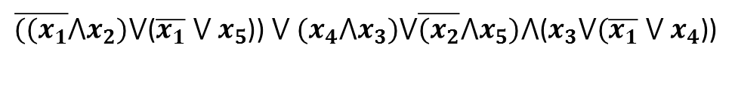
$$x_{1}$$ | $$x_{2}$$ | $$x_{3}$$ | $$x_{4}$$ | $$x_{5}$$
1 | 1 | 1 | 1 | 1
0 | 1 | 1 | 1 | 0
1 | 1 | 1 | 0 | 0
0 | 0 | 0 | 1 | 0
1 | 1 | 0 | 1 | 0
1 | 1 | 1 | 0 | 1
1 | 1 | 1 | 0 | 1
$\overline{{((x}_{1}}$⋀$x_{2})\text{⋁}\text{(}\overline{x_{1}}\text{ ⋁ }x_{5}$)) ⋁ ${(x}_{4}\text{⋀}x_{3})\text{⋁}\overline{{(x}_{2}}\text{⋀}x_{5})\text{⋀}\text{(}x_{3}\text{⋁}(\overline{x_{1}}\text{ ⋁ }x_{4}\text{)}\text{)}$
$\overline{{((x}_{1}}$ $\text{⋁} x_{2})\text{⋁}\text{(}\overline{x_{1}}\text{ ⋁ }x_{5}$)) ⋁ ${(x}_{4}\text{⋁}x_{3})\text{⋁}\overline{{(x}_{2}}\text{⋁}x_{5})\text{⋁}\text{(}x_{3}\text{⋁}(\overline{x_{1}}\text{ ⋁ }x_{4}\text{)}\text{)}$
$\overline{{((x}_{1}}\text{⋀}x_{2})\text{⋁}\text{(}\overline{x_{1}}\text{⋀}x_{5}$)) ⋁ ${(x}_{4}\text{⋀}x_{3})\text{⋁}\overline{{(x}_{2}}\text{⋀}x_{5})\text{⋁}\text{(}x_{3}\text{⋁}(\overline{x_{1}}\text{⋀}x_{4}\text{))}$

Slide 14
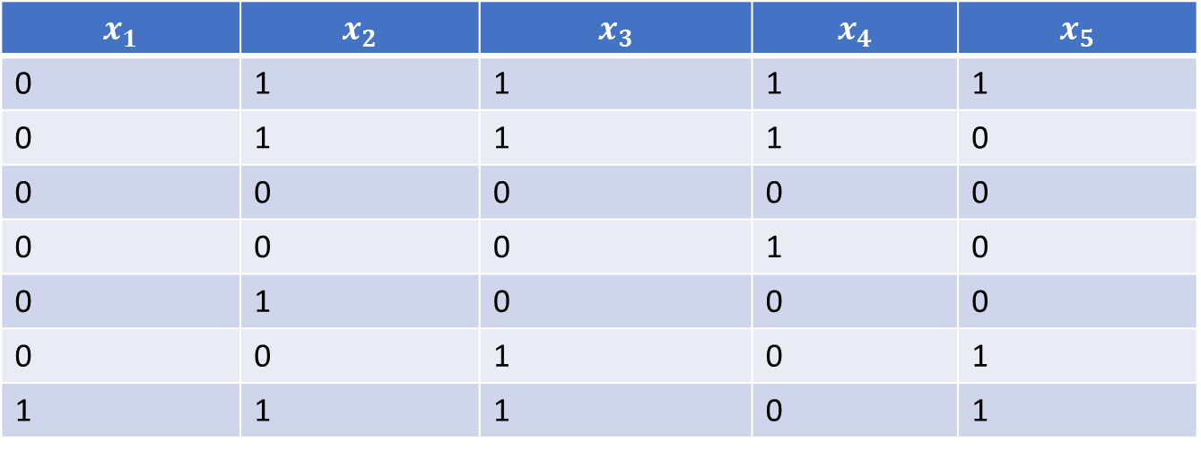
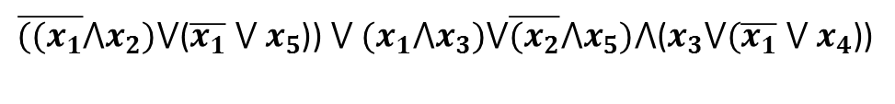
$$x_{1}$$ | $$x_{2}$$ | $$x_{3}$$ | $$x_{4}$$ | $$x_{5}$$
0 | 1 | 1 | 1 | 1
0 | 1 | 1 | 1 | 0
0 | 0 | 0 | 0 | 0
0 | 0 | 0 | 1 | 0
0 | 1 | 0 | 0 | 0
0 | 0 | 1 | 0 | 1
1 | 1 | 1 | 0 | 1
$\overline{{((x}_{1}}$⋀$x_{2})\text{⋁}\text{(}\overline{x_{1}}\text{ ⋁ }x_{5}$)) ⋁ ${(x}_{1}\text{⋀}x_{3})\text{⋁}\overline{{(x}_{2}}\text{⋀}x_{5})\text{⋀}\text{(}x_{3}\text{⋁}(\overline{x_{1}}\text{ ⋁ }x_{4}\text{)}\text{)}$
$\overline{{((x}_{1}}$ $\text{⋁} x_{2})\text{⋁}\text{(}\overline{x_{1}}\text{ ⋁ }x_{5}$)) ⋁ ${(x}_{4}\text{⋁}x_{1})\text{⋁}\overline{{(x}_{2}}\text{⋁}x_{5})\text{⋁}\text{(}x_{3}\text{⋁}(\overline{x_{1}}\text{ ⋁ }x_{4}\text{)}\text{)}$
$\overline{{((x}_{1}}\text{⋀}x_{2})\text{⋁}\text{(}\overline{x_{1}}\text{⋀}x_{5}$)) ⋁ ${(x}_{4}\text{⋀}x_{5})\text{⋁}\overline{{(x}_{2}}\text{⋀}x_{5})\text{⋁}\text{(}x_{2}\text{⋁}(\overline{x_{1}}\text{⋀}x_{3}\text{))}$

Slide 15
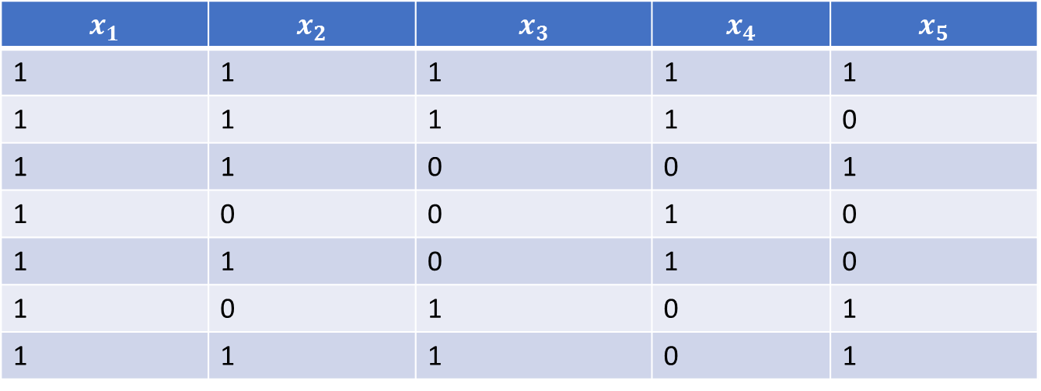
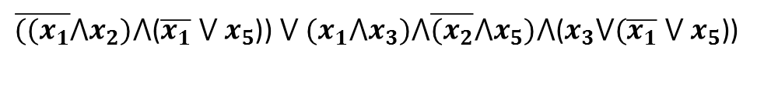
$$x_{1}$$ | $$x_{2}$$ | $$x_{3}$$ | $$x_{4}$$ | $$x_{5}$$
1 | 1 | 1 | 1 | 1
1 | 1 | 1 | 1 | 0
1 | 1 | 0 | 0 | 1
1 | 0 | 0 | 1 | 0
1 | 1 | 0 | 1 | 0
1 | 0 | 1 | 0 | 1
1 | 1 | 1 | 0 | 1
$\overline{{((x}_{1}}$⋀$x_{2})\text{⋀}\text{(}\overline{x_{1}}\text{ ⋁ }x_{5}$)) ⋁ ${(x}_{1}\text{⋀}x_{3})\text{⋀}\overline{{(x}_{2}}\text{⋀}x_{5})\text{⋀}\text{(}x_{3}\text{⋁}(\overline{x_{1}}\text{ ⋁ }x_{5}\text{)}\text{)}$
$\overline{{((x}_{1}}$ $\text{⋁} x_{2})\text{⋁}\text{(}\overline{x_{1}}\text{ ⋁ }x_{5}$)) $\text{⋀}$ ${(x}_{4}\text{⋁}x_{1})\text{⋁}\overline{{(x}_{2}}\text{⋁}x_{5})\text{⋀}\text{(}x_{3}\text{⋁}(\overline{x_{1}}\text{ ⋁ }x_{4}\text{)}\text{)}$
$\overline{{((x}_{1}}\text{⋀}x_{2})\text{⋁}\text{(}\overline{x_{1}}\text{⋀}x_{5}$)) ⋁ ${(x}_{4}\text{⋀}x_{5})\text{⋁}\overline{{(x}_{2}}\text{⋀}x_{5})\text{⋁}\text{(}x_{2}\text{⋀}(\overline{x_{1}}\text{⋀}x_{3}\text{))}$

